Slide 1



Transforming Education in Bo
working together with

Slide 2

Notes:
The United Nations designed a set of 17 goals for the world to work on together to make life better and fairer for everyone.
These are the Sustainable Development Goals, aka Global Goals.
One World Link believes these goals are really important for our friends in Sierra Leone who faces a lot of challenges especially in health and education.
Our focus is now on Goal 4-Quality Education – this starts with teachers…

Slide 3



In One World Link we are helping to celebrate World Teachers’ Day by launching our appeal to support teacher training in Bo - partnering with EducAid.

Slide 4

Have a look at the teachers where you are now and give them a smile to say
“Thank You”
It is a day to celebrate how teachers are transforming education but also to reflect on the support they need to “fully deploy their talent and vocation.” Teachers need CPD (continuing professional development)
World Teachers’ Day is co-convened in partnership with the International Labour Organization (ILO), UNICEF and Education International (EI).

Slide 5
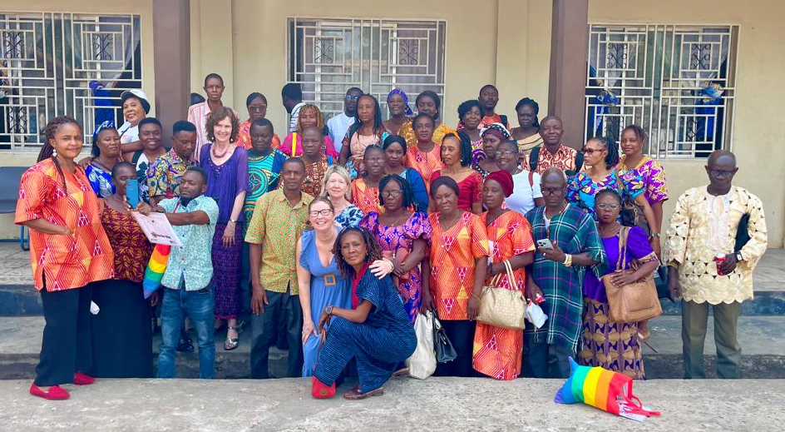
Here are some of the OWL teachers in Bo, visited by some Warwick/Leamington teachers in February 2025. They also need CPD and are excited to be part of our project.

Slide 6
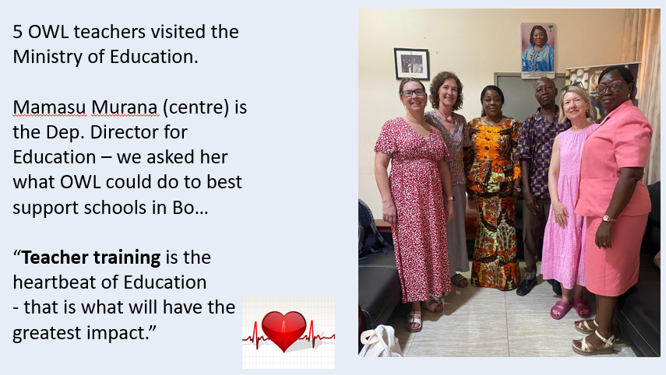
Notes:
In February a group of Warwickshire teachers travelled to Sierra Leone and met with the country’s Dep. Director for Education.
She encouraged us to do anything we could to help develop teachers and improve the quality of the education in SL.

Slide 7
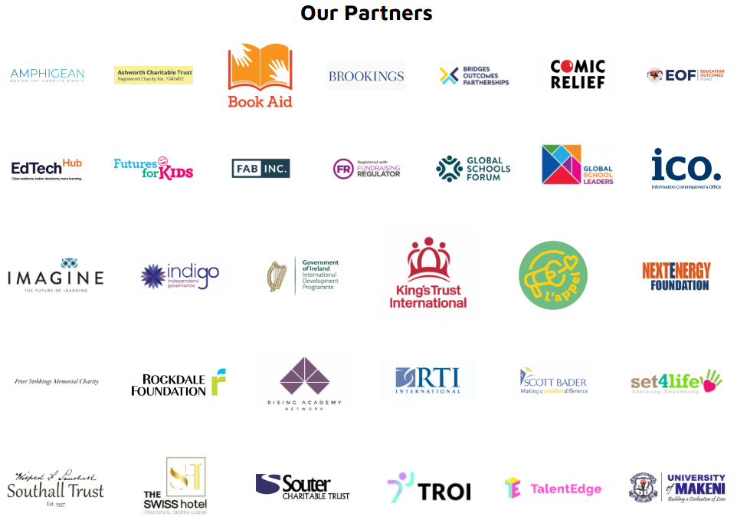
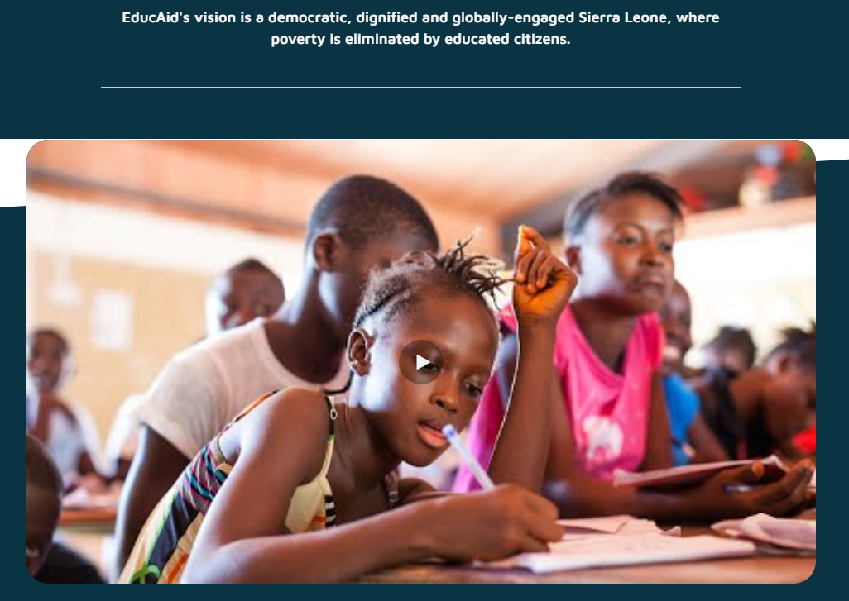
Who are EducAid?
Watch intro clip (3 mins)-Who are EducAid and why are we different:
https://www.educaid.org.uk/
EducAid's vision is a democratic, dignified and globally-engaged Sierra Leone, where poverty is eliminated by educated citizens.
Notes:
This link takes you to the home-page- scroll down for the 3 min video. (Good link to a child’s “Right to education”)
Some of the language is too hard for KS1, but the images speak for themselves, so worth showing.
Do you recognise any of the partners supporting EducAid? (Comic Relief, Book Aid)
OWL is going to be added to this list of partners!
If no time to watch the video – explain that EducAid is a charity who have been working to support education in SL for over 30 years and they want to work in Bo, with our help!

Slide 8
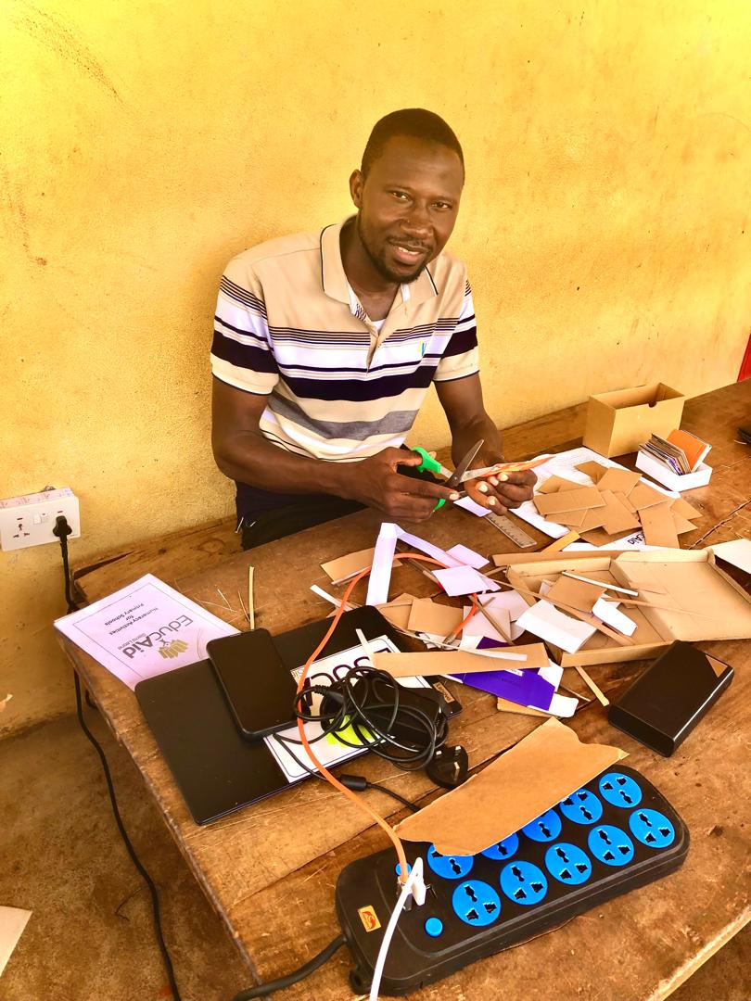
JP Sannoh
EducAid mentor/trainer, now living in Bo at the OWL centre
List of the 5 OWL participating schools,
and their UK partners, in this pilot year
2025-2026
BDEC Messima, Bo (St Margaret’s Whitnash)
RC Madonna, Bo (St Peter’s Leamington)
UMC Messima, Bo (Harbury Primary)
UBC Upper, Bo (Brookhurst, Leamington)
UBC Lower, Bo (Ferncumbe, Hatton)
All the other 10 link schools will also benefit from some teacher training.
Notes:
Mr Sheku JP Sannoh (known as JP) has been selected by EducAid to work as the trainer in 5 of our link schools. He moved to Bo with his wife and baby at the end of August.

Slide 9
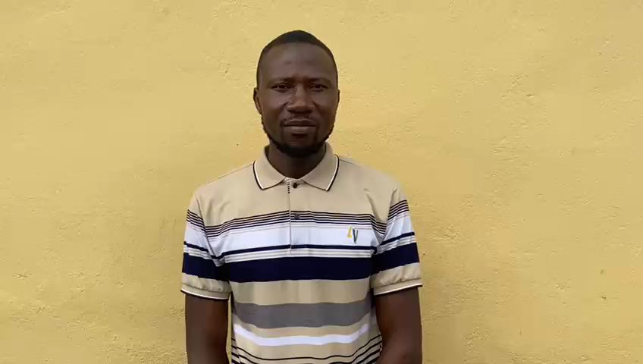
Here’s JP talking about his new job working with the teachers in 5 of our link schools
Notes:
Watch this clip (1min 20) where JP explains what he’ll be doing in Bo.

Slide 10
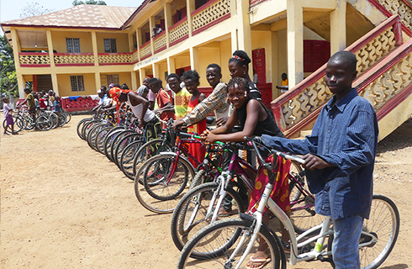

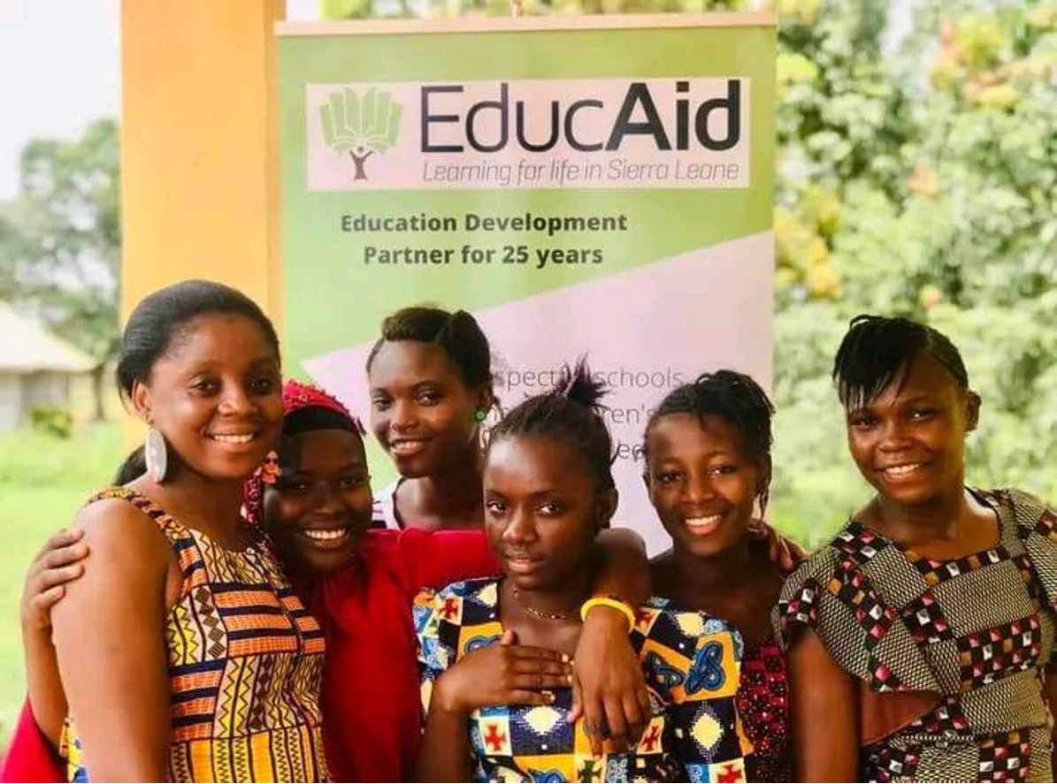

In 2024 they celebrated 30 years of developing education in Sierra Leone.
Notes:
EducAid has been working within Education in SL for just over 30 years.
It is run by Sierra Leoneans and supported by a charity network in UK.

Slide 11
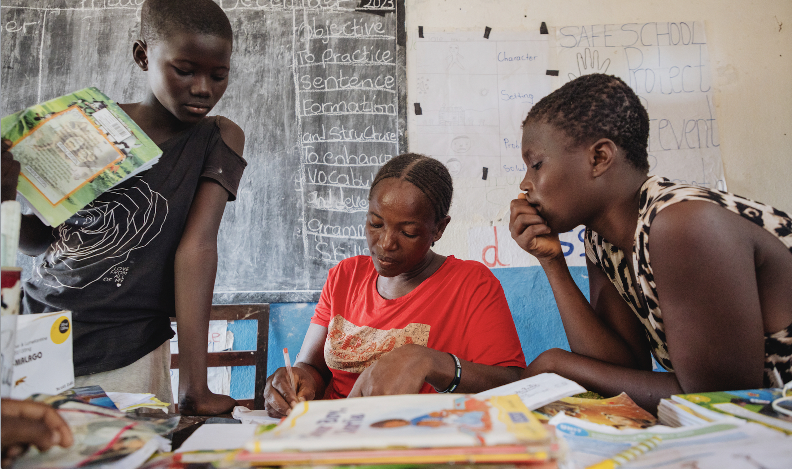
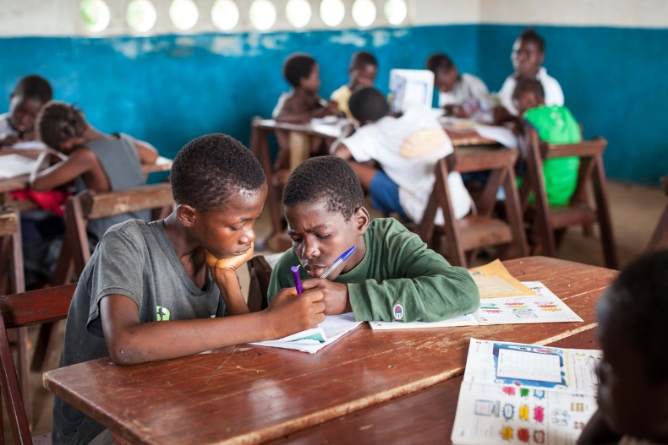
EducAid’s findings:
According to the Global Education Policy Dashboard, in 2022, only 3.2% of SL children achieve basic proficiency in maths and language by end of primary
95.8% of children aged 10 are not achieving basic proficiency in reading.” (World Bank, 2023)
EducAid believes: Teachers don’t learn from manuals or handouts, they learn from seeing/experiencing – this is why EducAid has created teaching videos and uses a coach/mentor to teach teachers.
OWL’s findings
Very few schools had evidence of using concrete materials such as phonics cards
There is a lot of rote learning and repeating back what the teacher says, parrot-style
Children are often just copying from the board, not actually being encouraged to think for themselves

Slide 12
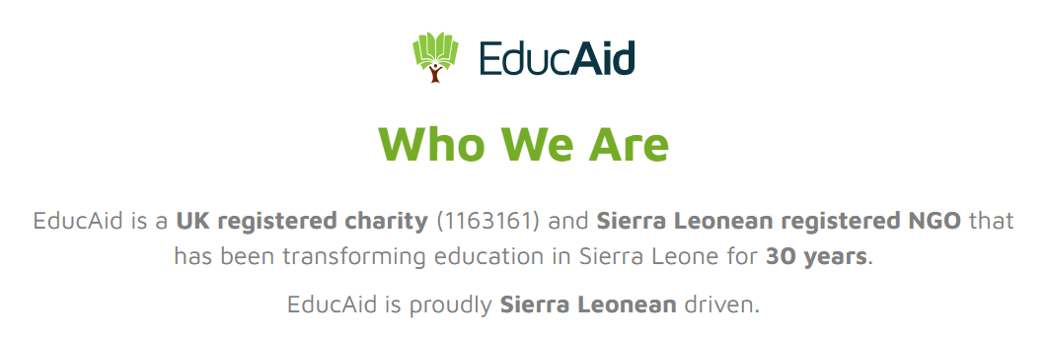
EducAid provides training and mentoring for primary school teachers and heads in Sierra Leone
The proposed scheme has the support of the Ministry of Basic and Senior Secondary Education (MBSSE) at national and district levels.
The project starts with EducAid holding consultations with the communities as well as the schools to ensure that their process and intended outcome are understood.
It continues with training for heads and teachers.
The training is based on their ‘Ten Top Strategies for Teaching and Learning’ which, for many teachers, requires a transformation of their approaches to the children and to the subjects they teach.
For the rest of the school year an EducAid mentor spends a full day each week with each school to ensure that the strategies are being implemented and embedded and to monitor progress.

Slide 13
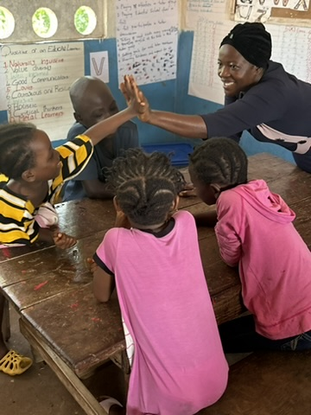
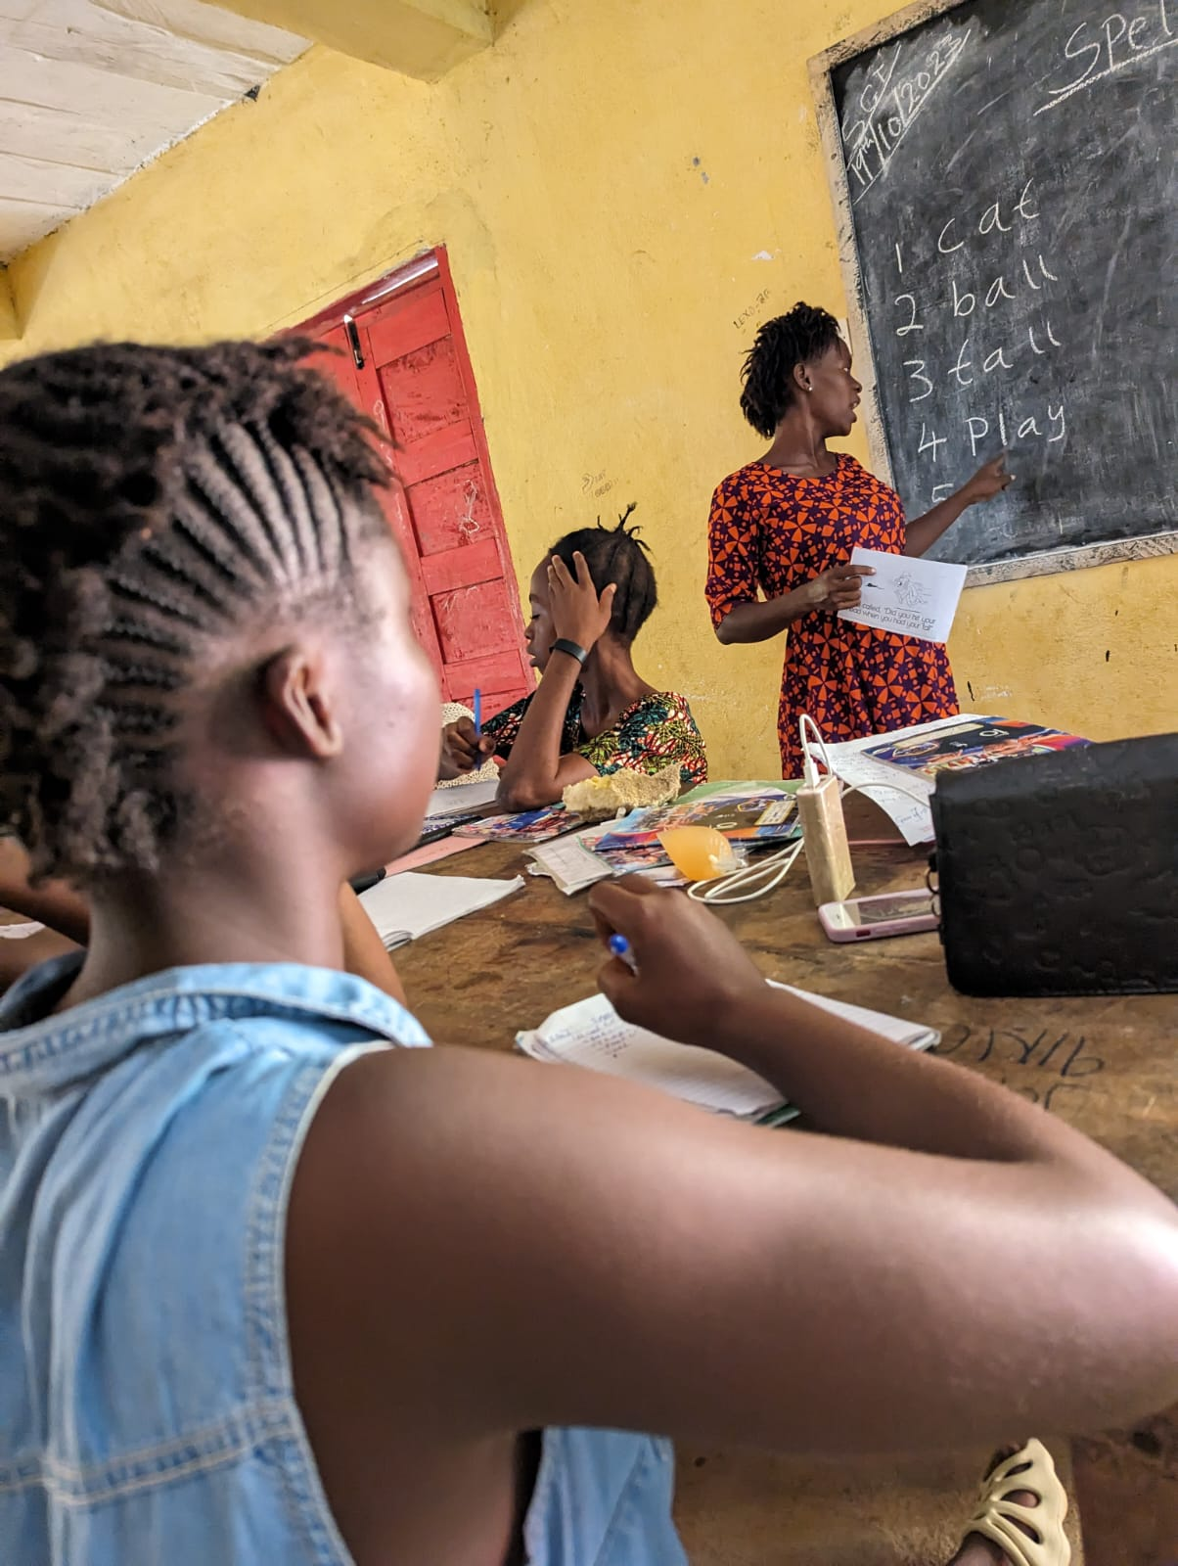

Teachers using EducAid’s Top Ten Strategies
Group Children Purposefully
High Five learning with EducAid

Slide 14
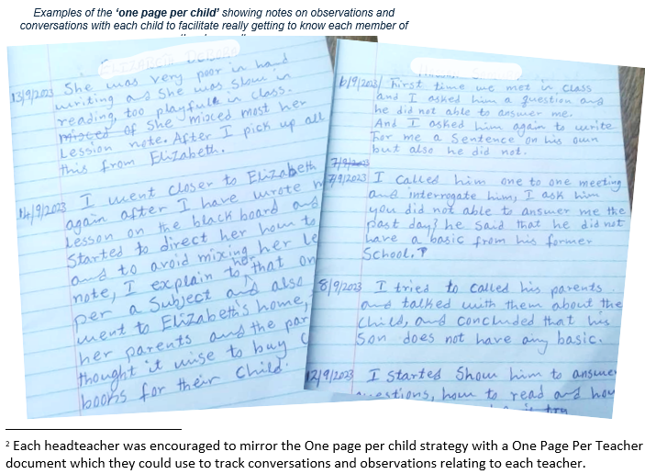
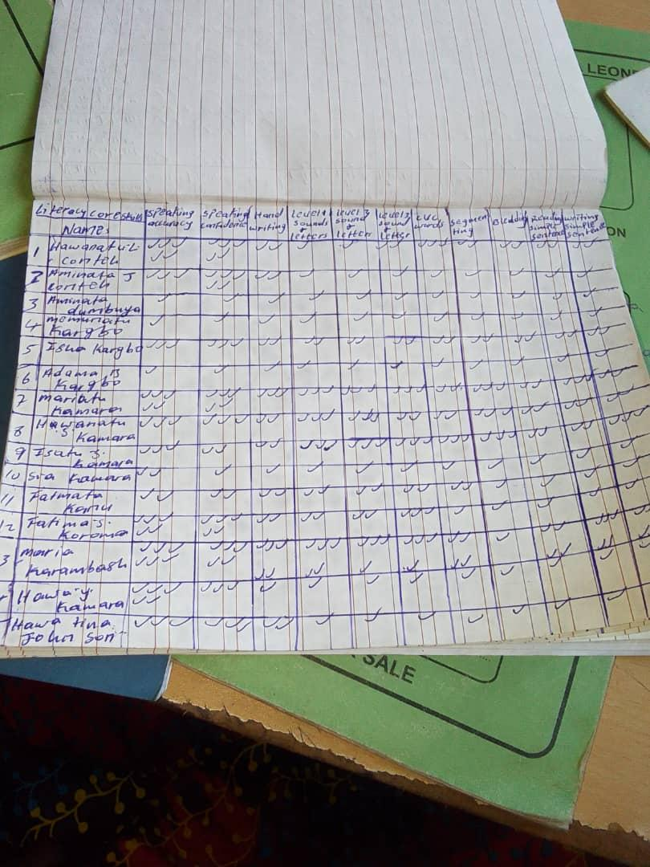

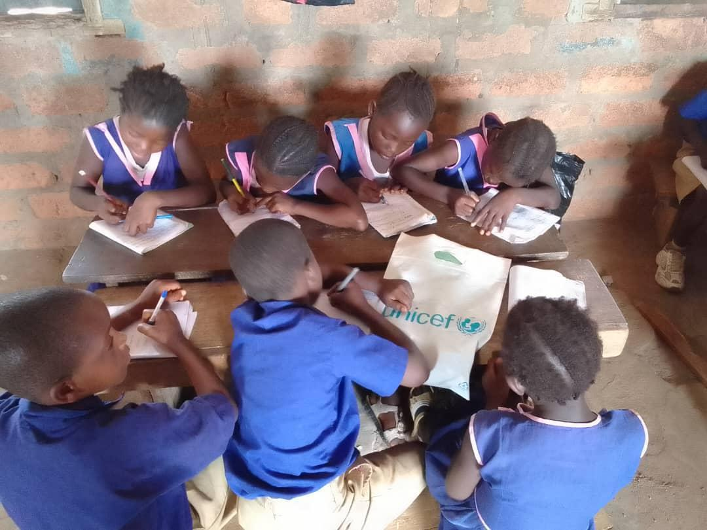
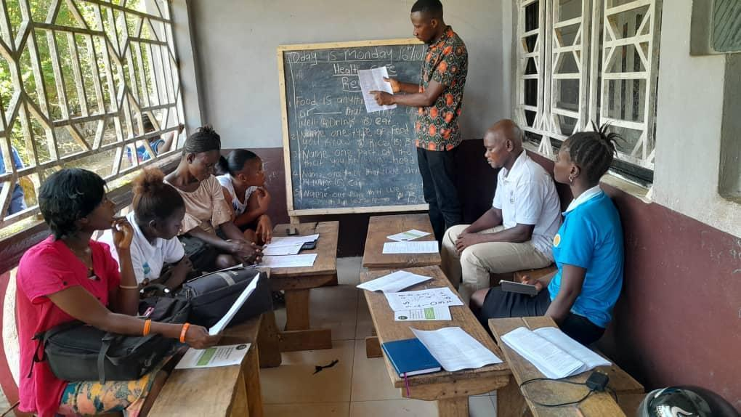
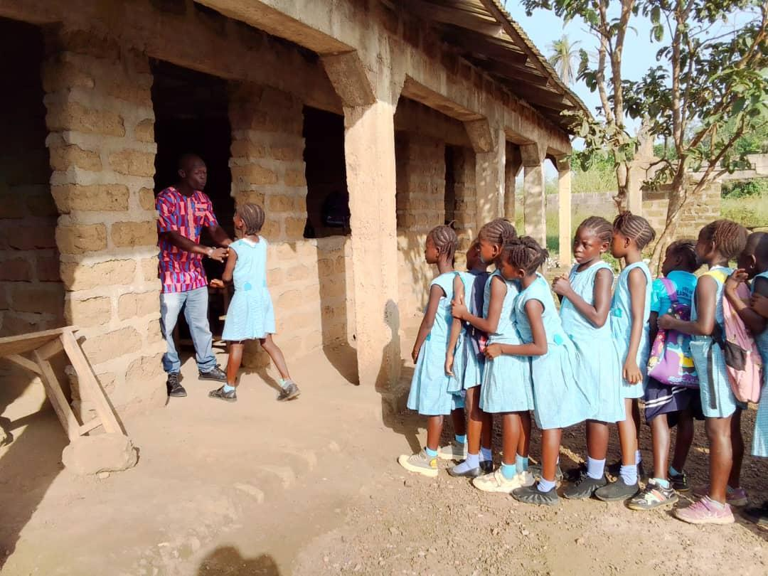
EducAid
Teacher Training
using the
Top Ten Strategies
An example of a core skills tracker, showing a tick for each time the teacher notices the child demonstrating that skill. A lack of ticks may indicate absence, inability or that the teacher has not taken notice of them yet, prompting further enquiry and action by the teacher
Strategy 7 - Group Children Purposefully
Lunchtime coaching sessions with teachers
Strategy 1 -Teacher welcomes the children into the lesson by name, at the classroom door

Slide 15
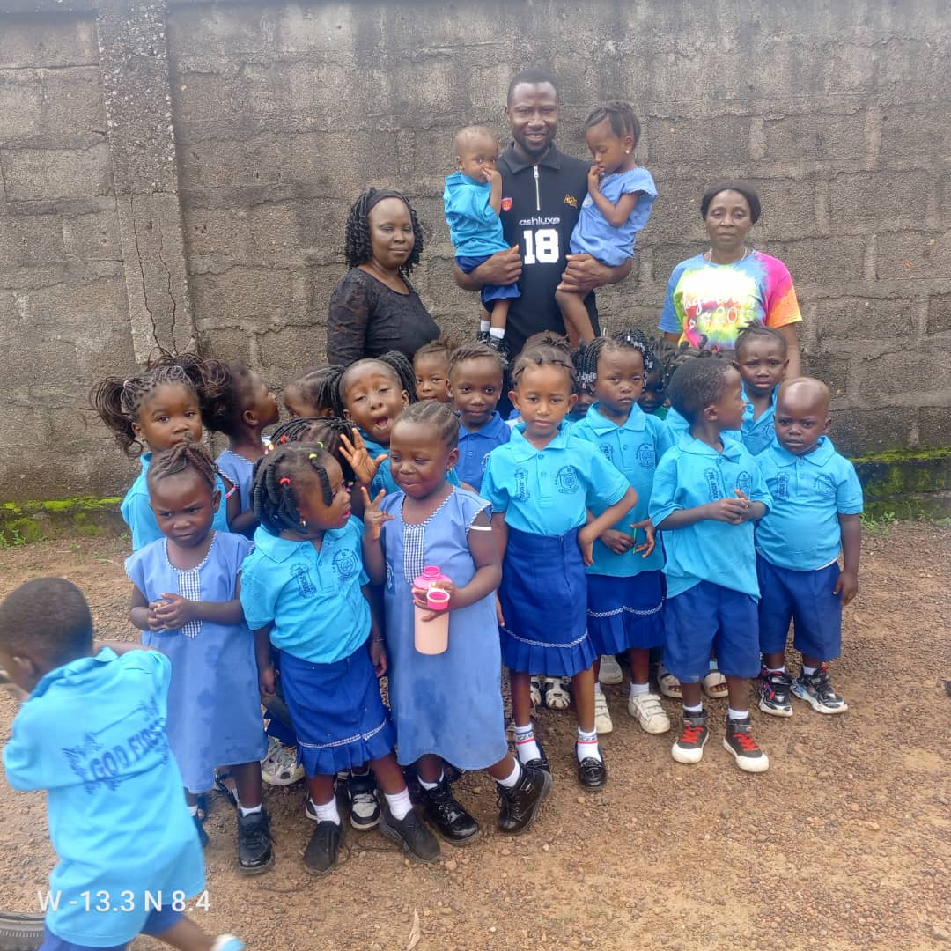
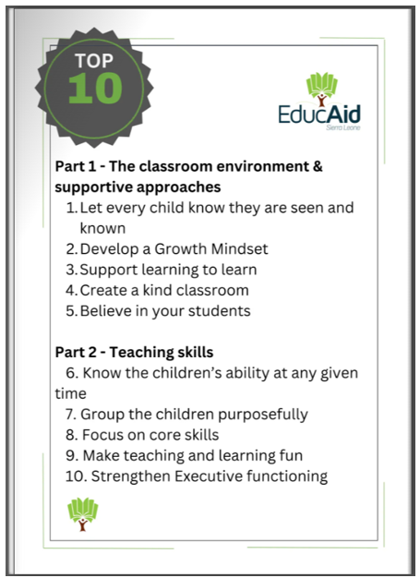
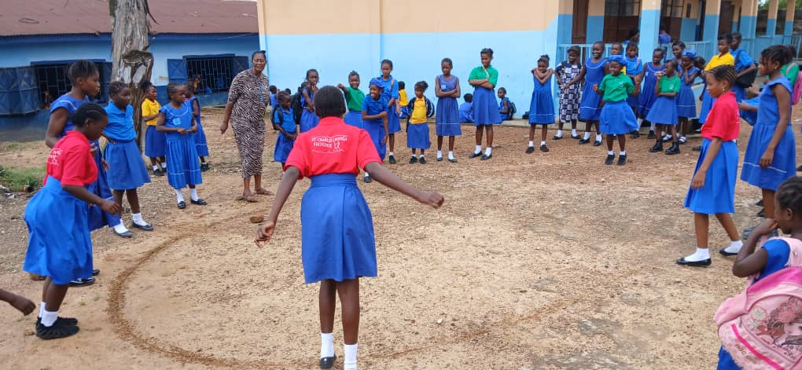
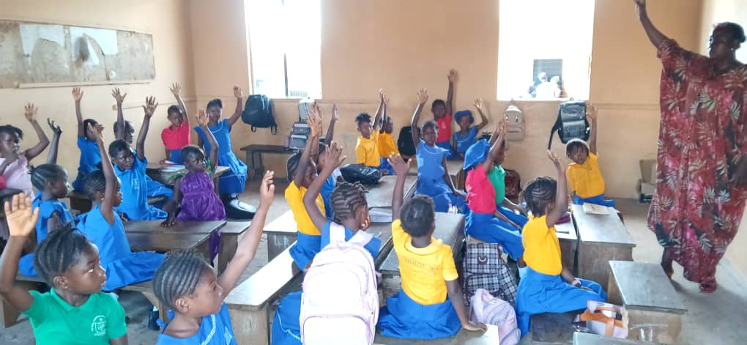
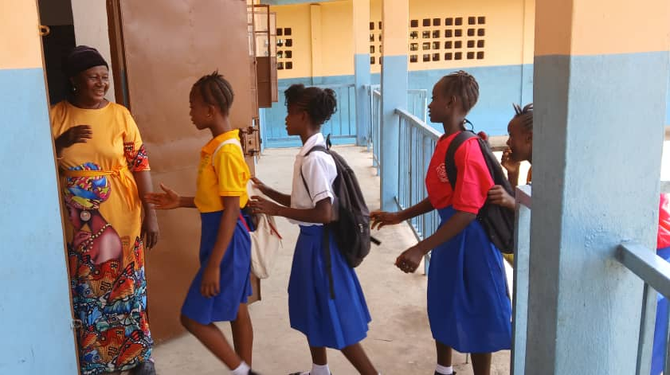
Recent photos sent on WhatsApp, demonstrating the Top Ten Strategies being used in our Bo Link schools

Slide 16
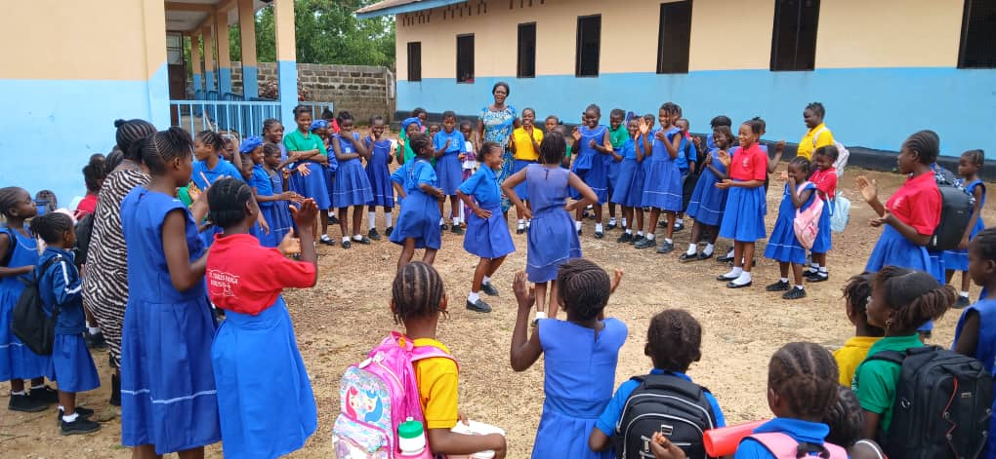
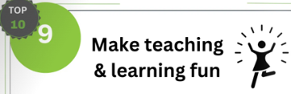
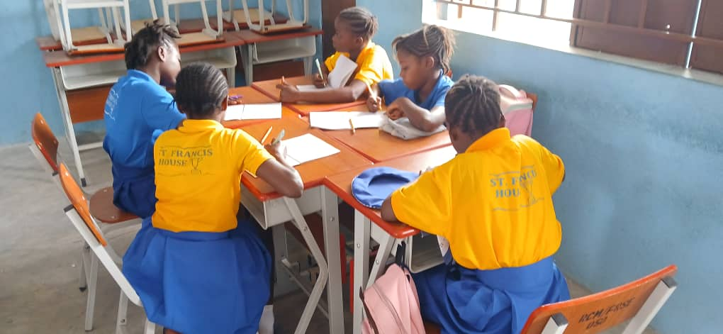
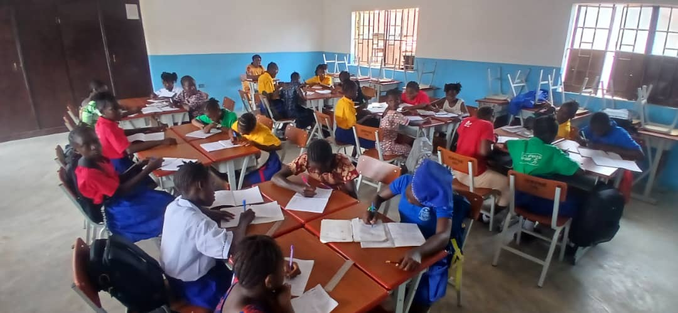
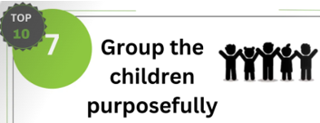

Slide 17


Fundraising
Insert or explain what your school is planning to do to raise money for this EducAid project this school year?

Slide 18
Top Ten Strategies
You may wish to skip over the next few slides but could make children aware what they are: the manual which JP spoke about to support teachers.

Slide 19
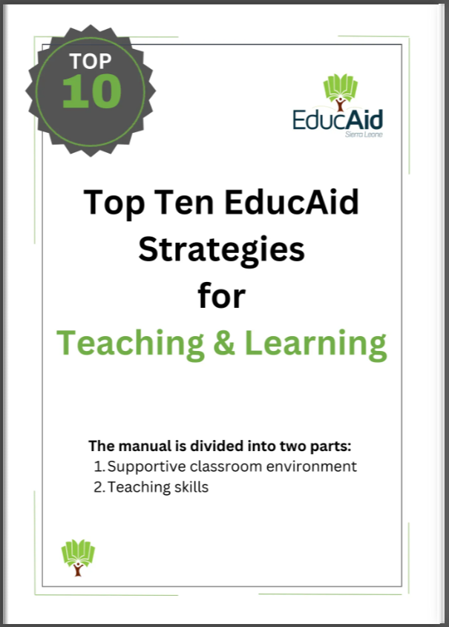
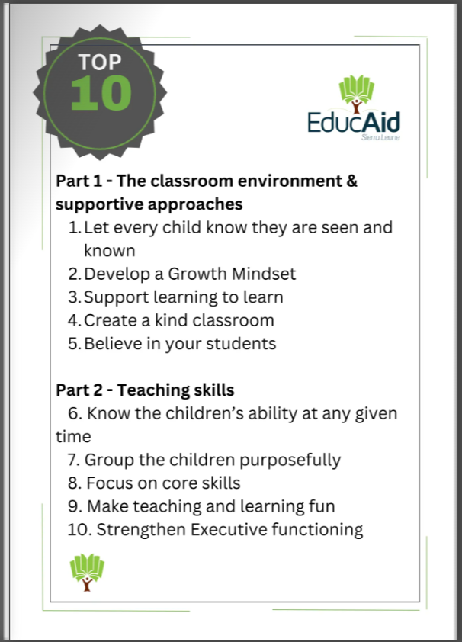
Part 1
Teacher-Pupil relationships -
prioritising classroom culture is crucial – respectful relationships
Part 2
technical changes in pedagogy

Slide 20
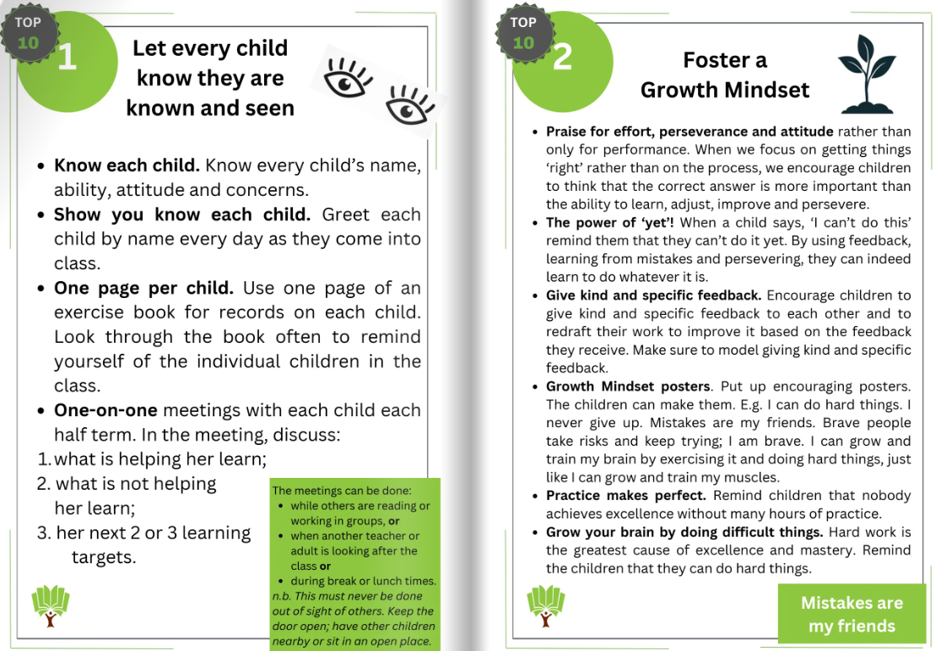

Slide 21
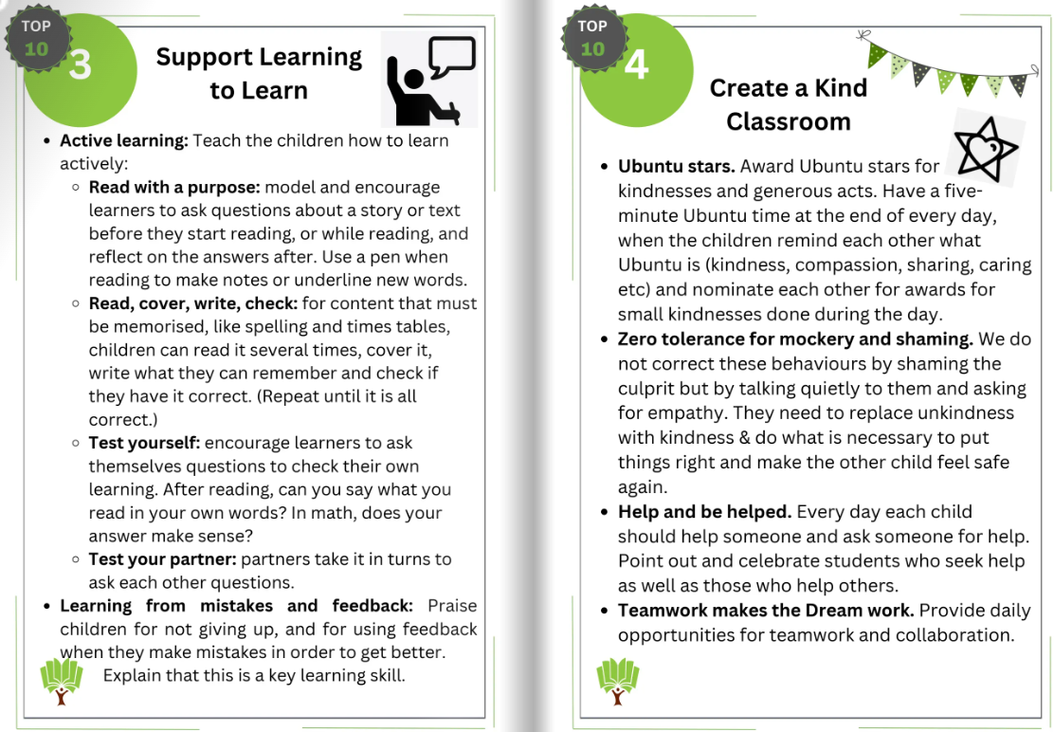

Slide 22
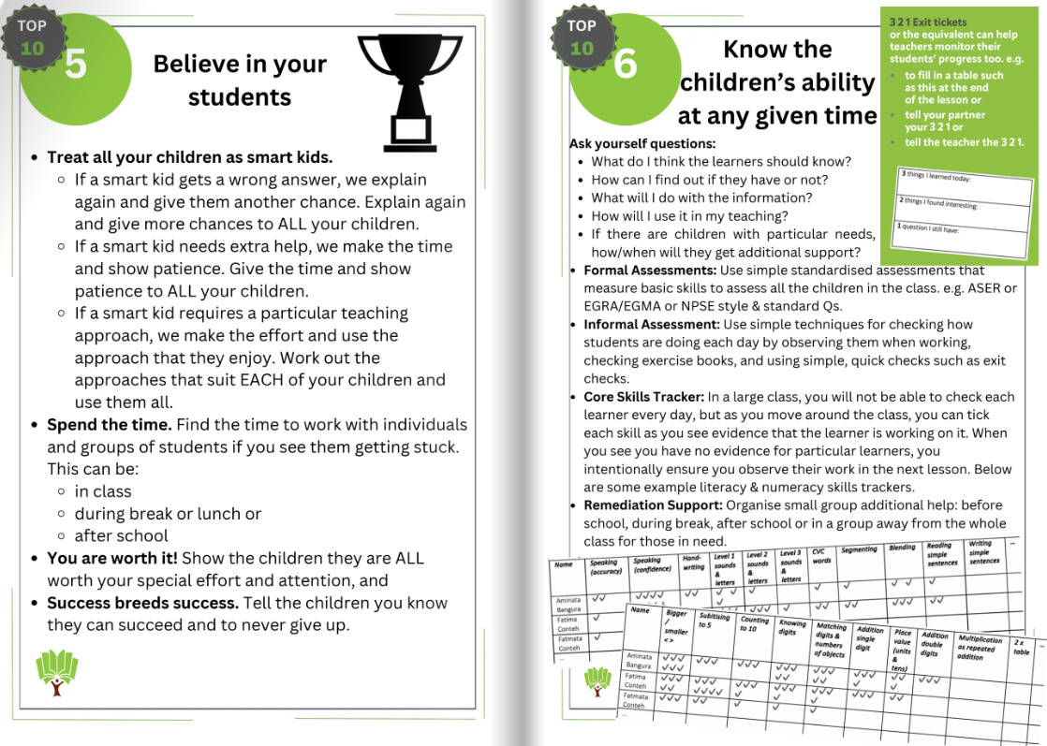

Slide 23
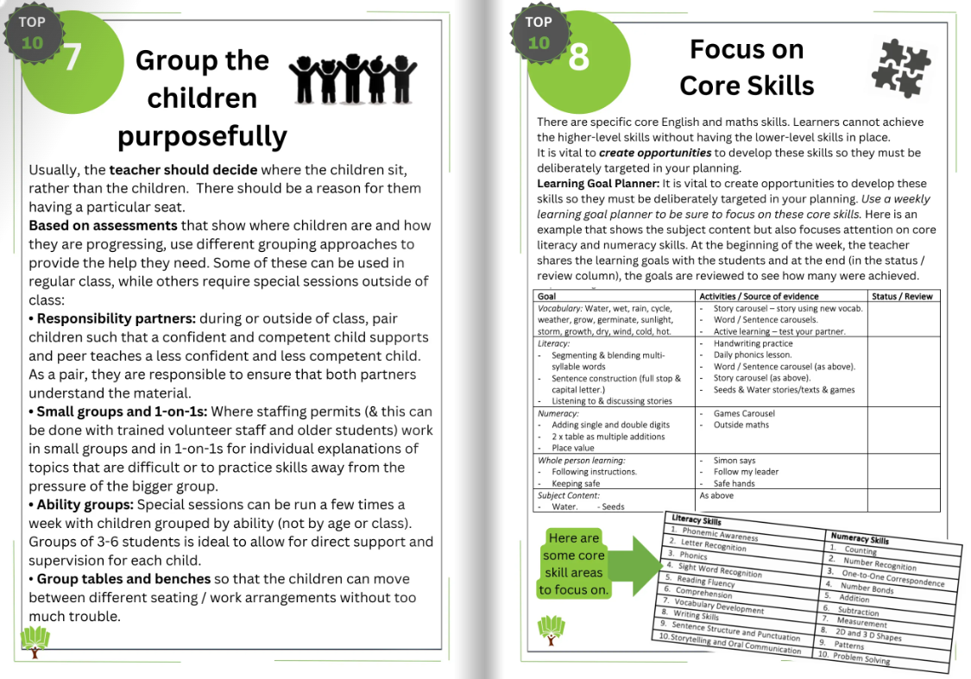

Slide 24
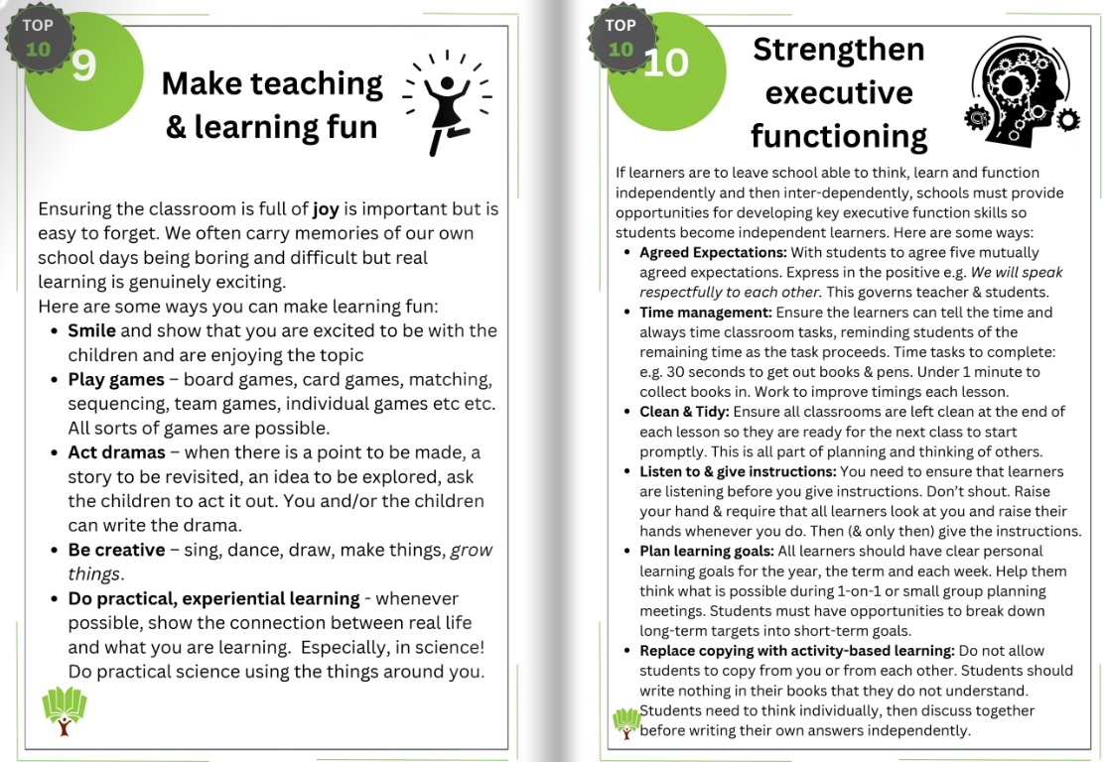
Watch Strategy 9, practice 3 video:
Notes:
If you have time, show this EducAid Teacher Training clip encouraging using games to make learning fun (3mins 30secs)

Slide 25
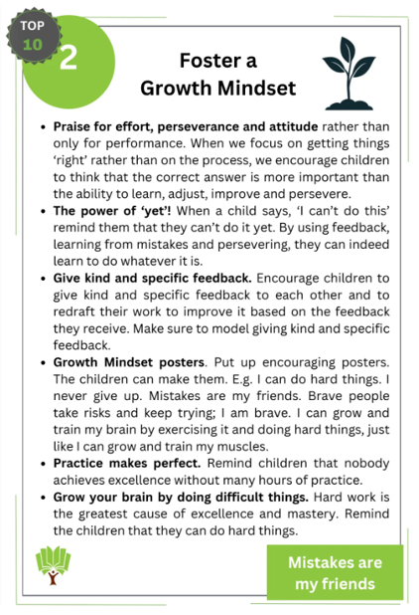
Exchange Project – Oct 2025
OWL schools are making Growth Mindset posters to send out to our link schools in Bo
Discuss what it means to have a ‘Growth Mindset’
Why is it so helpful?
Why are teachers in Bo being taught this strategy?
Discuss what you could put on a poster to help explain this strategy to others. What images would help? Which words might help?
Your posters will be sent to Bo to help the children there (you might like to keep copies for your own classroom, after all, some of us also find it tricky to have a positive mindset!)
Notes:
Every year OWL schools take part in an exchange of work.
Exchange project: This year’s exchange activity, to be sent to your partner school in Bo, will involve children designing a poster on the theme of Foster a Growth Mindset (EducAid Top Ten Strategy 2). What does it mean? What does it look like in our classroom? In our school? Make the poster as visual as possible, colourful and engaging, …. You can make as many posters as you like, but minimum would be a class (approx. 30 posters). You could link your discussions with Global Goal 4 (Quality Education) and with EducAid Top Ten Strategies (especially Strategy 2)
Please remember to include a teacher-to-teacher letter, greeting your partner school, sharing news and giving details of your school/class activities so far regarding our OWL partnership. Another wonderful gesture is a letter from your Head to the Head of your partner school, especially if you have a new Head, introducing themselves and sending warm greetings. Remember to encourage them to participate in the OWL training, even if they’re not one of the 5 schools in this pilot year. Please put your posters in a A4 envelope, labelled with both your school and link school name.
Deadline: 24th October - end of this half-term, please, ready for collection.

Slide 26



Learning, together with Bo, how to be active global citizens
Notes:
OWL would like to thank us for working with them to teach about being active global citizens.

Slide 27
End of presentation

Slide 28
Next few slides provide text/images for school display
schools are partnering with EducAid Sierra Leone in a new exciting teacher training project. It will involve link schools in Bo who are ready and willing to develop teaching and learning using new approaches. We need to raise funds for the implementation of EducAid’s Top Ten Strategies. We strongly believe that the teachers and children in our link schools can benefit from EducAid’s research and expertise.

Slide 29
Logos

Slide 30
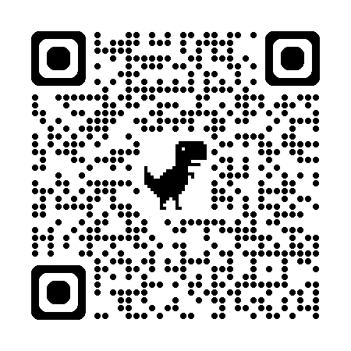



Here’s the link to our Just Giving page.
A big thank you from,
Transforming Education in Bo
Can you help us with a donation?
Here’s the link to our Just Giving page.
A big thank you from,
and

Slide 31

There are currently 30 OWL schools, 15 in Warwick district linked with 15 in Bo district. Over the past 14 years we have been working together to learn from each other and support teaching in both countries through various projects. We have benefitted from relevant and child-centred projects often linked to the Global Goals – exploring issues such as Climate Action, Plastic Waste and Responsible Consumption.
Most Bo schools receive very little professional development or support. The longstanding relationships within OWL have enabled us to now start working with a partner Sierra Leonean organisation, EducAid www.educaid.org.uk For over 30 years they have been developing teacher mentoring and training which has been proven to be very effective - helping schools improve outcomes for both staff and children.
EducAid's vision is a democratic, dignified and globally-engaged Sierra Leone, where poverty is eliminated by educated citizens. OWL are delighted to be working alongside such a well established and vibrant organisation.

Slide 32




