Slide 1
Wellesbourne CE Primary International Week June 2018
Focus on Bo and Sierra Leone
Cross curricular

Slide 2
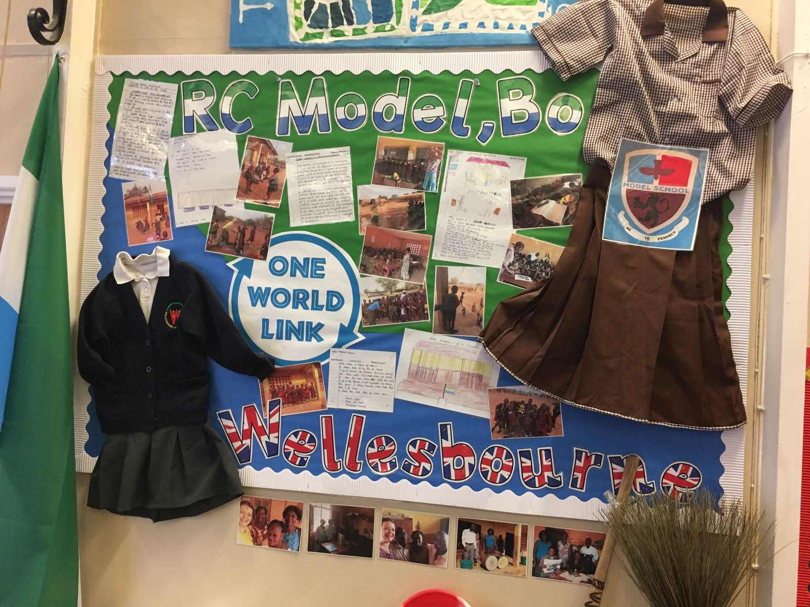

Slide 6
